Slide 1
Chapter 3 : Assembly Level Machine Organization
The connection and attachment of parts, subassemblies, and modules in a definite sequence to produce a finished machine.
A module is a detachable or nondetachable grouping of parts.

Slide 2
Von Neumann Machine Model
Model for designing and building computers, based on the following three characteristics:
  The computer consists of the following main sub-systems:
    Memory
    CPU(ALU & CU)
    Input/Output System (I/O)
All computers more or less based on the same basic design, of the Von Neumann Architecture!

Slide 3
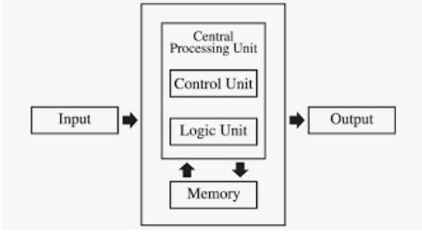
Von Neumann Architecture

Slide 4
Memory Unit
Memory unit is a component of a computer system which is used to store data, instructions and information.
It is actually a work area of computer, where the CPU stores the data and instruction. It is also known as a main/primary/internal memory.
How does processing unit get data to/from memory?
Most processors have multiple registers, called a register array, that hold data and instructions that must be accessed rapidly during the execution of an application.

Slide 5
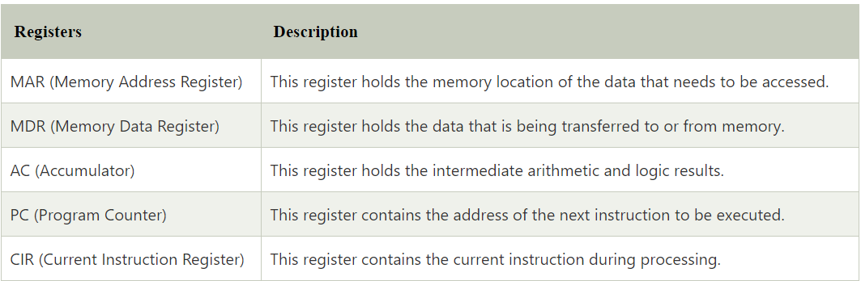
Cont…

Slide 6
CONT…
To read a location (A):
Write the address (A) into the MAR.
Send a “read” signal to the memory.
Read the data from MDR.
To write a value (X) to a location (A):
Write the address (A) into the MAR
Write the data (X) to the MDR.
Send a “write” signal to the memory.

Slide 7
Control Units

Slide 8
Cont…
Control unit:
  Reads an instruction from memory
  The instruction’s address is in the PC
  Interprets the instruction, generating signals
  that tell the other components what to do.
  An instruction may take many machine cycles to complete.

Slide 9
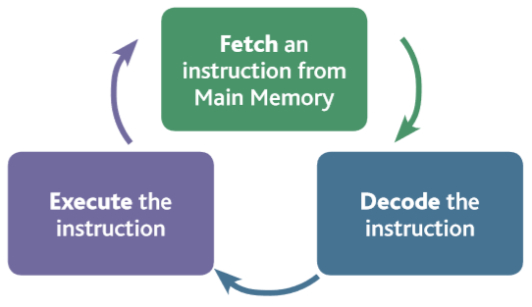
Instruction Process
Executing a single instruction consists of a particular cycle of events; fetching, decoding, executing and storing.

Slide 10
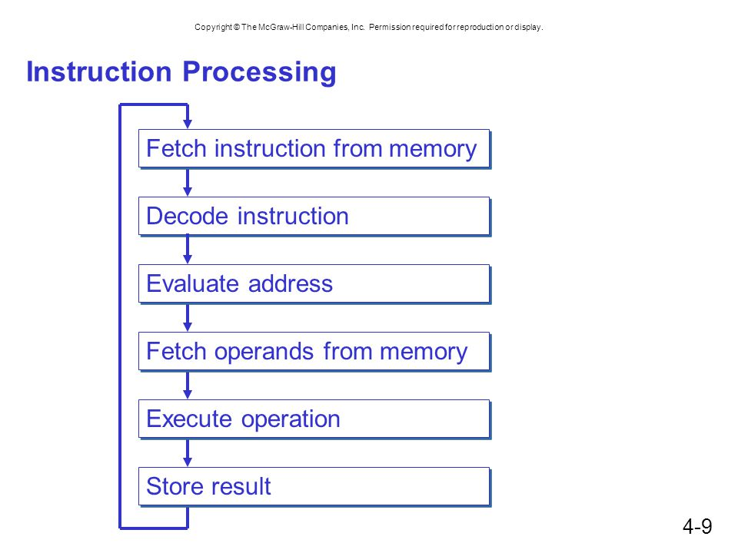
The steps for executing an instruction:
  Fetch the instruction
  Decode the instruction
  Locate the operand
  Fetch the operand
  Execute the operation.
  Store the results
  Go back to step 1

Slide 11
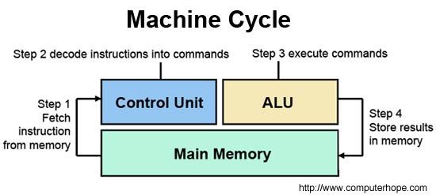
Cont…

Slide 12
Instruction and Instruction Set
E.g. A command is a specific instruction given to a computer application to perform some kind of task or function.
An instruction set is a group of commands for a CPU in machine language. The term can refer to all possible instructions for a CPU or a subset of instructions to enhance its performance in certain situations.
Some instructions are simple read, write and move commands that direct data to different hardware.
The instruction set provides commands to the processor, to tell it what it needs to do.
These instructions direct the computer in terms of data manipulation.

Slide 13
Instruction Set Architectures
There are a large number of different CPUs, and they don’t all use the same instruction set. That means they will not interpret numbers for instructions the same way.
The architecture of the Central Processing Unit (CPU) operates the capacity to function from “Instruction Set Architecture” to where it was designed.
E.g. In one CPU architecture 501012 may mean add r10, r12 while in another architecture it may mean load r10, 12.
So ,Instruction Set Architectures is the set of processor design techniques used to implement the instruction work flow on hardware.
This includes the functional definition of operations and precise descriptions of how to invoke and access them.
Therefore ,the architectural design of the CPU is either Reduced instruction set computing (RISC) or Complex instruction set computing (CISC).

Slide 14
Reduced Instruction Set Computers (RISCs)
A reduced instruction set computer (RISC) is a computer which only use simple instructions that can be divide into multiple instructions which perform low-level operation within single clock cycle.
It is computer designed to simplify the individual instructions given to the computer in order to realise a task.
RISC computer, a task might require more instructions (code) in order to realise a task, because the individual instructions are written in simpler code.
The key operational concept of the RISC computer is that each instruction performs only one function (e.g. copy a value from memory to a register).

Slide 15
Complex Instruction Set Computers (CISCs)
A complex instruction set computer (CISC) is a computer where single instructions can execute several low-level operations (such as a load from memory, an arithmetic operation, and a memory store) or are capable of multi-step operations.
Examples of CISC architectures include complex mainframe computers to simplistic microcontrollers where memory load and store operations are not separated from arithmetic instructions.

Slide 16
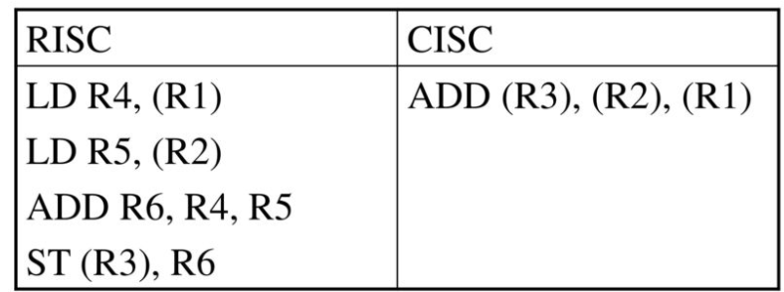
CISC VS RISC

Slide 17
Cont…
Having an operation broken into small instruction (RISC) allows the compiler to optimize the code.
The CISC instruction has no option but to wait for its operands to come from memory potentially delaying other instruction .

Slide 18
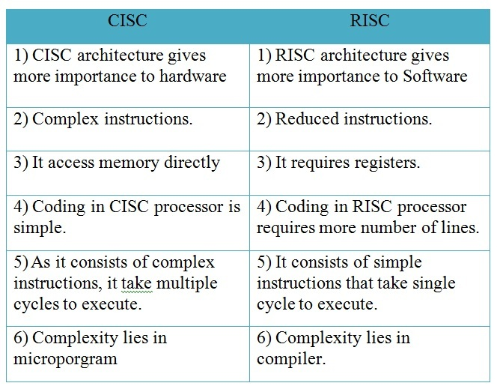
CISC VS RISC

Slide 19
Properties of RISC
  Store/load are the only memory accesses.
  Data manipulation instructions are register-to-register.
  Simple addressing mode.
  Instruction formats are all the same length.
  Instructions perform elementary operations.
  One instruction per cycle (simple instruction).

Slide 20
Properties of CISC
  Memory access is available to most types of instruction.
  Many addressing mode (substantial in number).
  Instruction formats are of different lengths.
  Instructions perform both elementary and complex operations (microinstructions are then necessary.
  Multiple cycle for executing one instruction (complex instruction).

Slide 21
Instruction Type
The type of instructions forming the instruction set of a machine is an indication of the power of the fundamental architecture of the machine.
Instructions can in general be classified as in the following Sub sections.
    Data Movement Instruction
    Arithmetic Logic Instruction
    Sequencing Instruction
    Input/Output Instruction

Slide 22
Data Movement Instructions
Data movement instructions are used to move data among the different units of the machine.
Most particularly among these are instructions that are used to move data among the different registers in the CPU.
A simple register to register movement of data can be made through the instruction.
e.g MOVE R1, R2
This instruction moves the content of register R2 to register R1.
The effect of the instruction is to override the contents of the (destination) register R1 without changing the contents of the (source) register R2.

Slide 23
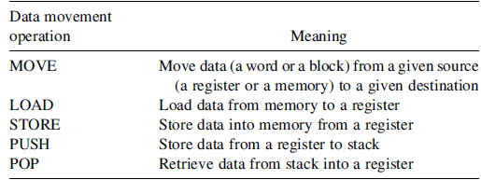
Some Common Data Movement Operations

Slide 24
Arithmetic and Logical Instructions
Arithmetic and logical instructions are those used to perform arithmetic and logical manipulation of registers and memory contents.
Examples of arithmetic instructions are:-
      ADD R1,R2,R0
      SUBTRACT R1,R2,R0
The first instruction adds the contents of source registers R0 and R2 and stores the result in destination register R1(three address instruction).
The second instruction subtracts the contents of the source registers R0 and R2 and stores the result in the destination register R1.
The contents of the source registers are unchanged by the ADD and the SUBTRACT instructions.

Slide 25
Sequencing Instructions
The order in which the instructions in a program are carried out. Normally the sequence proceeds in a linear fashion through the program, and the address of the instructions is obtained from the program counter in the control unit.
Control (sequencing) instructions are used to change the sequence in which instructions are executed.
They take the form of Conditional Branching (conditional jump), Unconditional Branching (jump), or Call instructions.
Unconditional Jump Instructions: Transfers the program sequence to the described memory address while Conditional Jump Instructions Transfers the program sequence to the described memory address only if the condition in satisfied.
A common characteristic among these instructions is that their execution changes the program counter (PC) value. The change made in the PC value can be unconditional.
In this case, the earlier value of the PC is lost and execution of the program starts at a new value specified by the instruction.
Consider, for example, the instruction JUMP NEW-ADDRESS.

Slide 26
Input/Output Instructions
Input and output instructions (I/O instructions) are used to transfer data between the computer and peripheral devices.
The two basic I/O instructions used are the INPUT and OUTPUT instructions.
The INPUT instruction is used to transfer data from an input device to the processor which interfaced with a computer through dedicated input ports.
Suppose that the input port through which a keyboard is connected to a computer carries the unique address 1000.
Therefore, execution of the instruction INPUT 1000 will cause the data stored in a specific register in the interface between the keyboard and the computer, call it the input data register, to be moved into a specific register (called the accumulator) in the computer.

Slide 27
Output Instruction
Similarly, the execution of the instruction OUTPUT 2000 causes the data stored in the accumulator to be moved to the data output register in the output device whose address is 2000.
Alternatively, the computer can address these ports in the usual way of addressing memory locations.
In this case, the computer can input data from an input device by executing an instruction such as MOVE Ro, Rin.
This instruction moves the content of the register Rin into the register R0.
Similarly, the instruction MOVE Rin, R0 moves the contents of register R0 into the register Rin, that is, performs an output operation.

Slide 28
Instruction Format
  An instruction is normally made up of a combination of an operation code and some way of specifying an operands.
  So, Instructions can be classified based on the number of operands as:
      Three-address
      Two-address
      One address
      Zero-address

Slide 29
Three Address
A three-address instruction takes the form operation add-1, add-2, add-3.
In this form, each of add-1, add-2, and add-3 refers to a register or to a memory location.
Consider, for example, the instruction ADD R1,R2,R3.
This instruction indicates that the operation to be performed is addition.
It also indicates that the values to be added are those stored in registers R3 and R2 that the results should be stored in register R1.

Slide 30
Two Address
A two-address instruction takes the form operation add-1, add-2. In this form, each of add-1 and add-2 refers to a register or to a memory location.
Consider, for example, the instruction ADD R1,R2.
This instruction adds the contents of register R1 to the contents of register R2 and stores the results in register R1.
The original contents of register R1 are lost due to this operation while the original contents of register R2 remain intact.

Slide 31
One Address
A one-address instruction takes the form ADD R1.
In this case the instruction implicitly refers to a register, called the Accumulator Racc, such that the contents of the accumulator is added to the contents of the register R1 and the results are stored back into the accumulator Racc.
If a memory location is used instead of a register then an instruction of the form ADD B is used.
In this case, the instruction adds the content of the accumulator Racc to the content of memory location B and stores the result back into the accumulator Racc.

Slide 32
Zero Address
These are the instructions that use stack operation.
A stack is a data organization mechanism in which the last data item stored is the first data item retrieved.
Two specific operations can be performed on a stack.
These are the push and the pop operations.
As can be seen, a specific register, called the stack pointer (SP), is used to indicate the stack location that can be addressed.
In the stack push operation, the SP value is used to indicate the location (called the top of the stack) in which the value is to be stored.

Slide 33
Computer Language
In order for a computer to be able to execute a program, the program must first be present in binary form within the computer's memory.
However, writing a program directly in binary form is completely out of the question.
The solution to this conflict is for the programmer to write a program in a more suitable language and then to use a special computer program to translate it into the binary machine code necessary for the target computer.
When preparing software for a microprocessor system, the designer must first select the particular language in which to write the programs.
Three classes of computer languages exist: machine languages, assembly languages, and higher-level languages.

Slide 34
Machine Language
A computer is a binary machine.
Machine to communicate with each other must be in binary form.
A program shown in binary form as to reflect these values is said to be in machine language.
Machine language is the most basic and elementary form in which any program can exist.

Slide 35
Assembly Language
It is a programming language which uses mnemonics(symbols) to write a program.
It is machine dependent-refer the meaning from the sentence under machine language.
An assembly language is a low-level programming language for microprocessors and other programmable devices.

Slide 36
High Level Language
It is not machining dependent –this means it can be used on different machine with little modifications.
It easier to learn and understand because it resembles/look like English.
Require less time to write and easier to debug errors.
Some examples of high level programming languages are:
C, C++, FORTRAN, COBOL, C#, Java ,PHP. Python and etc.

Slide 37
Language Translators
Programs that translate a program written in high level language or assembly language to machine code program are called translators.
There are three types of language translators.
Assembler (translate assembly into machine language)
Interpreter (translates just one statement of the program at a time into machine code) An interpreter takes very less time to analyze the source code
Compiler(Compiler scans the entire program and translates the whole of it into machine code at once.)

Slide 38
Address Mode
The different ways in which operands can be addressed are called the addressing modes.
Addressing modes differ in the way the address information of operands is specified.
The simplest way for an instruction to specify an operand is to include the operand rather than an address or some other information describing where the operand is.
The number of values is limited by the size of the field.

Slide 39
Cont…
There are different types of address modes such as:
Immediate Addressing
Stack Addressing Mode
Direct Addressing
Indirect Addressing
Register Addressing
Register Indirect Addressing
Relative Addressing
Indexed Addressing

Slide 40
Immediate Addressing mode
Include the operand itself in the instruction, that is, no address information is needed.
The operand is specified in the instruction explicitly.
Instead of address field, an operand field is present that contains the operand.
Operand is part of instruction
It is also called as implicit addressing mode.
Operand = address field
e.g. ADD 5
Add 5 to contents of accumulator
5 is operand

Slide 41
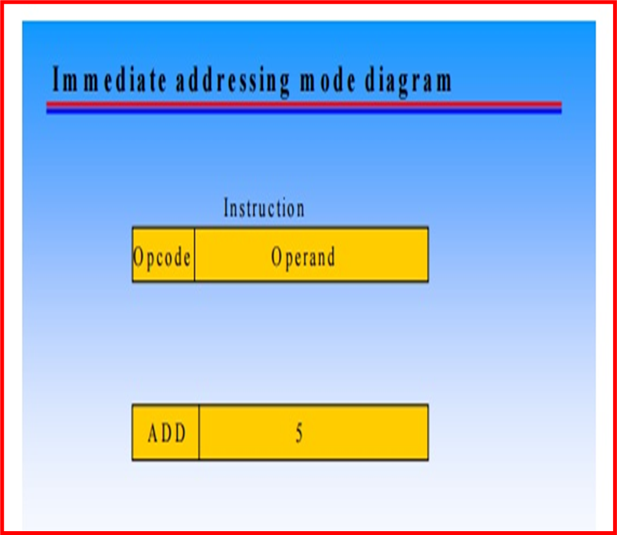
Cont…

Slide 42
Stack Addressing Mode
The operand is contained at the top of the stack.
Example-
ADD
This instruction simply pops out two symbols contained at the top of the stack.
The addition of those two operands is performed.
The result so obtained after addition is pushed again at the top of the stack.

Slide 43
Direct Addressing
The address field of the instruction contains the effective address of the operand in the memory.
Effective address (EA) = address field (A)
Example: ADD A .
Add contents of cell A to accumulator .
Look in memory at address A for operand
Single memory reference to access data
Only one reference to memory is required to fetch the operand.
It is also called as absolute addressing mode.

Slide 44
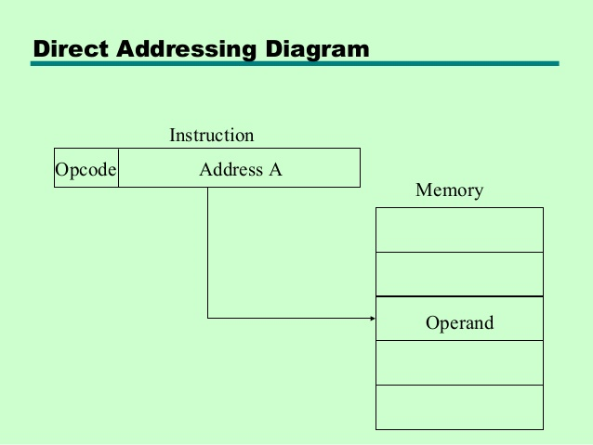

Slide 45
Indirect Addressing mode
The address field of the instruction specifies the address of memory location that contains the effective address of the operand.
The address field of the instruction gives the address at which the effective address is stored in memory.
Two references to memory are required to fetch the operand.

Slide 46
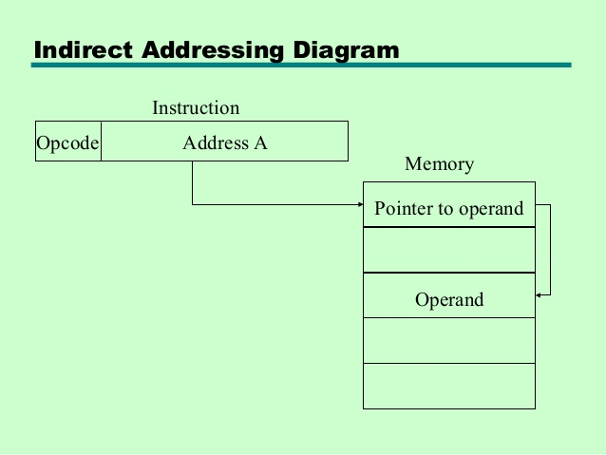
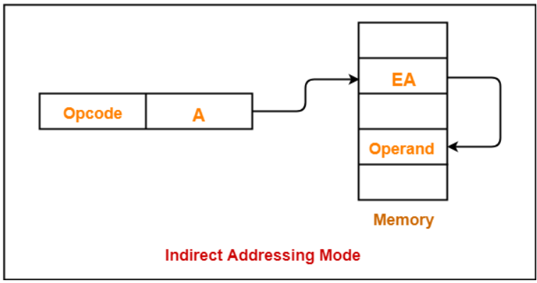

Slide 47
Register Direct Addressing Mode
The operand is contained in a register set.
The address field of the instruction refers to a CPU register that contains the operand.
Limited number of register and very small address field is needed.
Shorter instructions and faster instruction fetch.
No reference to memory is required to fetch the operand. Example
ADD R will increment the value stored in the accumulator by the content of register R.
AC ← AC + [R]

Slide 48
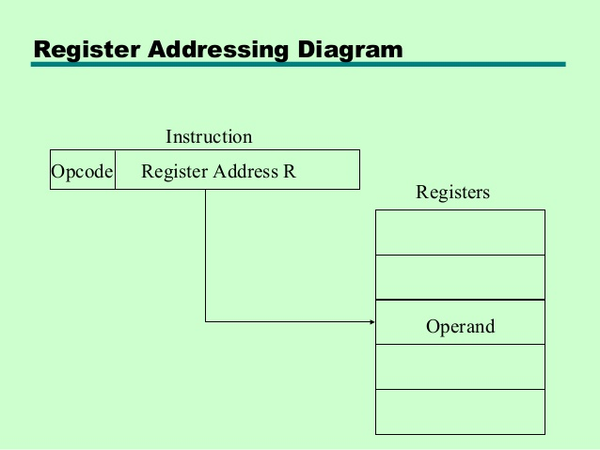

Slide 49
Register Indirect Addressing Mode
The address field of the instruction refers to a CPU register that contains the effective address of the operand.
Only one reference to memory is required to fetch the operand.
This addressing mode is similar to indirect addressing mode.
The only difference is address field of the instruction refers to a CPU register.

Slide 50
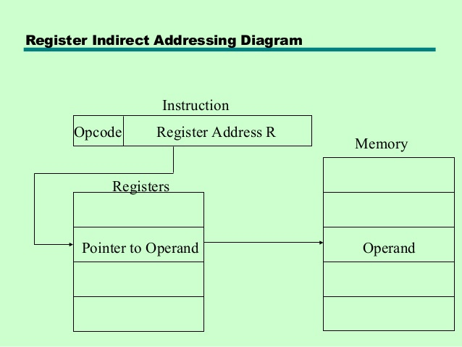
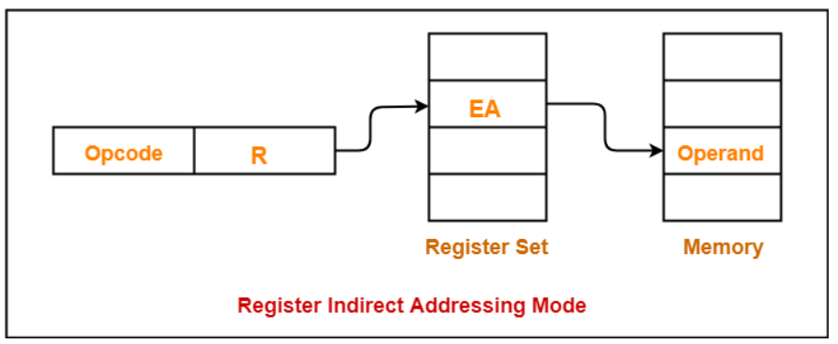

Slide 51
Relative Addressing Mode
Effective address of the operand is obtained by adding the content of program counter with the address part of the instruction.
In this mode effective address is obtained by adding displacement to PC. EA= PC + Address field value.
It is a version of displacement addressing.
Program counter (PC) always contains the address of the next instruction to be executed.
The address part of the instruction is called as offset and it can +ve or –ve. When the offset is added to the PC the resultant number is the memory location where the operand will be placed.

Slide 52
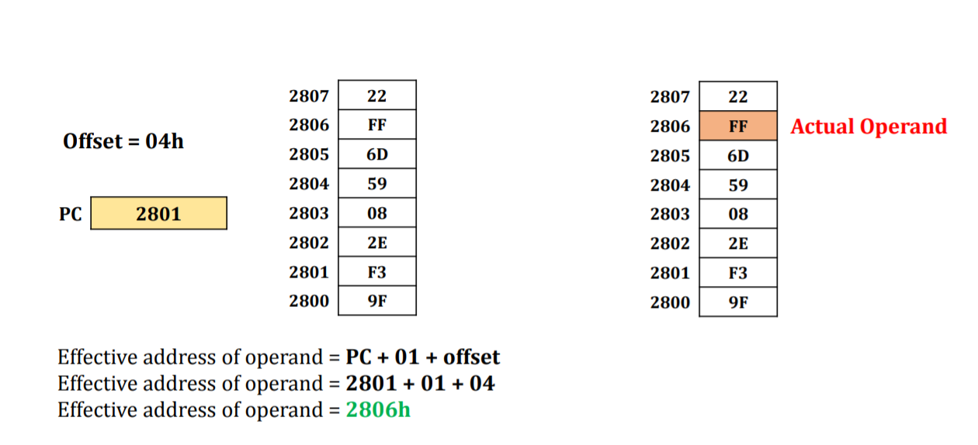
e.g

Slide 53
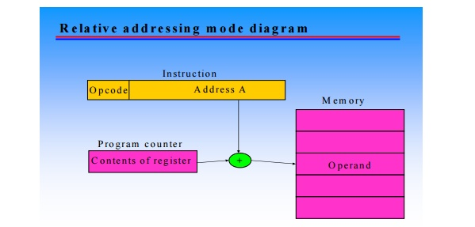

Slide 54
Indexed Addressing Mode
In index addressing mode, contents of Index register is added to address part of instruction to obtain effective address.
The address part of instruction holds the beginning/base address and is called as base.
The index register hold the index value, which is +ve.
Base remains same, the index changes.
When the base is added to the index register the resultant number is the memory location where the operand will be placed.
Address field hold two values
X = constant value (offset)
R = register that holds address of memory locations

Slide 55
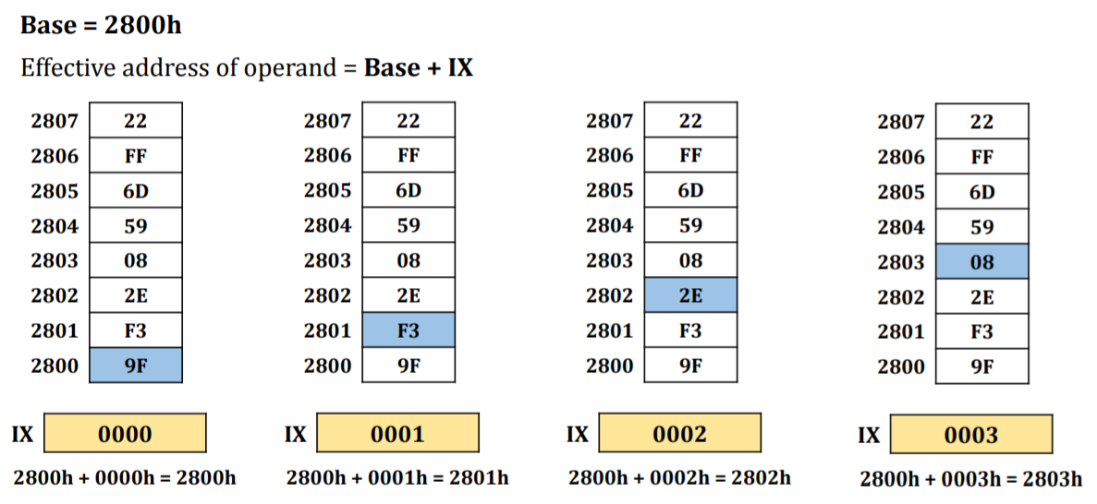
e.g

Slide 56
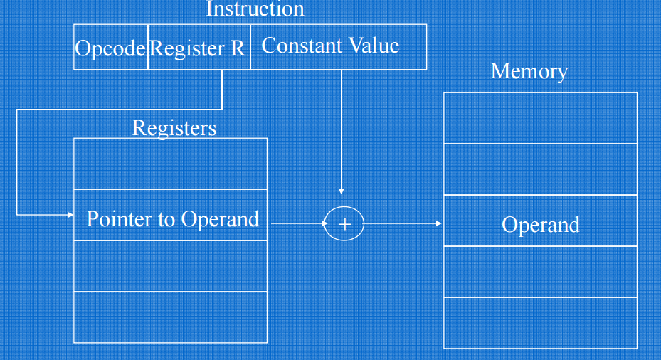
Indexed Addressing Mode Diagram

Slide 57
~~~~~~~~~~~~THE END~~~~~~~~~~~~~
`````````````````IF QUESTION?``````````````````

